Slide 1
Chapter 13
Properties of Solutions

Slide 2
1. The phrase "like dissolves like" refers to the fact that ________.
A) gases can only dissolve other gases
B) polar solvents dissolve polar solutes and nonpolar solvents dissolve nonpolar solutes
C) solvents can only dissolve solutes of similar molar mass
D) condensed phases can only dissolve other condensed phases
E) polar solvents dissolve nonpolar solutes and vice versa
B

Slide 3
2. Which one of the following substances is more likely to dissolve in benzene (C₆H₆)? ________
A) CH₃CH₂OH
B) NH₃
C) NaCl
D) CCl₄
E) HBr
D

Slide 4
3. Which one of the following is most soluble in hexane (C₆H₁₄)? ________
A) CH₃OH
B) CH₃CH₂CH₂OH
C) CH₃CH₂OH
D) CH₃CH₂CH₂CH₂OH
E) CH₃CH₂CH₂CH₂CH₂OH
E

Slide 5
4. The solubility of nitrogen gas at 25 °C and 1 atm is 6.8 × 10⁻⁴ mol/L. If the partial pressure of nitrogen gas in air is 0.76 atm, what is the concentration (molarity) of dissolved nitrogen? ________
A) 6.8 × 10⁻⁴ M
B) 5.2 × 10⁻⁴ M
C) 4.9 × 10⁻⁴ M
D) 3.8 × 10⁻⁴ M
E) 1.1 × 10⁻⁵ M
B
S_{g}=KP_{g}
6.8× 10-4 mol/L = K*1 atm
M= K * 0.76 atm
= 5.168 × 10-4 mol/L

Slide 6
5. Which of the following statements is false? ________
A) Nonpolar liquids tend to be insoluble in polar liquids.
B) The weaker the attraction between the solute and solvent molecules, the greater the solubility.
C) Substances with similar intermolecular attractive forces tend to be soluble in one another.
D) The solubility of a gas increases in direct proportion to its partial pressure above the solution.
E) The solubility of gases in water decreases with increasing temperature.
B

Slide 7
6. Which of the following choices has the compounds correctly arranged in order of increasing solubility in water? (least soluble to most soluble) ________
A) CCl₄ < CHCl₃ < NaNO₃
B) CH₃OH < CH₄ < LiF
C) CH₄ < NaNO₃ < CHCl₃
D) LiF < NaNO₃ < CHCl₃
E) CH₃OH < Cl₄ < CHCl₃
A

Slide 8
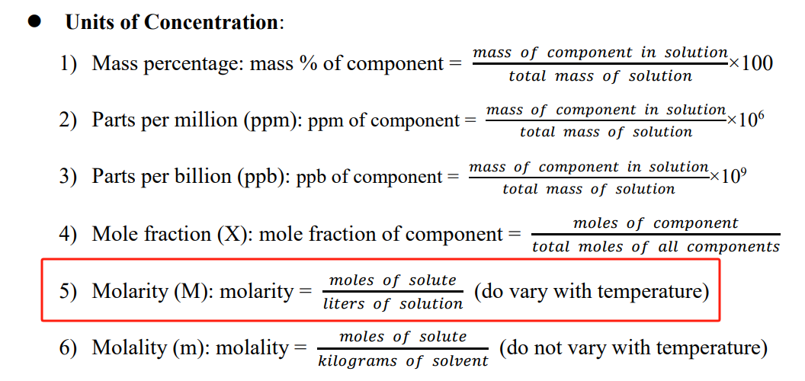
7. Which one of the following concentration units varies with temperature? ________
A) molarity
B) mass percent
C) mole fraction
D) molality
E) all of the above
A

Slide 9
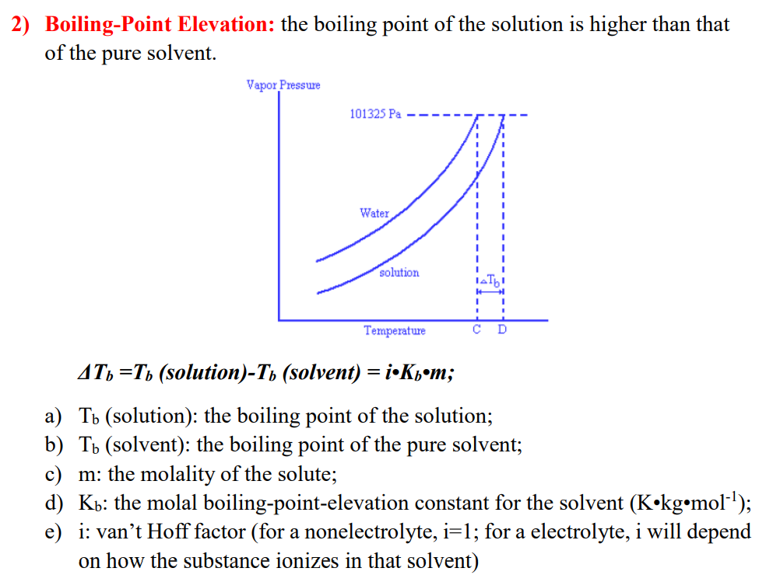
8. A 0.100 m solution of which one of the following solutes will have the lowest vapor pressure? ________
A) KClO₄
B) Ca(ClO4)₂
C) Al(ClO4)₃
D) sucrose
E) NaCl
C

Slide 10
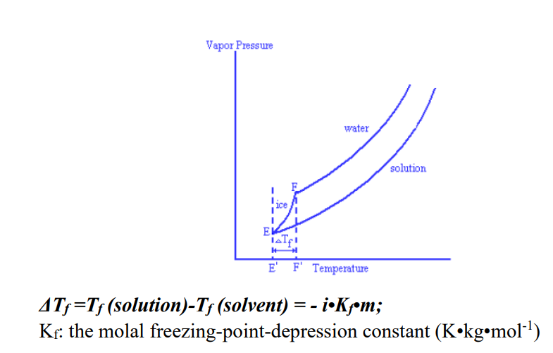
9. As the concentration of a solute in a solution increases, the freezing point of the solution ________ and the vapor pressure of the solution ________.
A) increases, increases
B) increases, decreases
C) decreases, increases
D) decreases, decreases
E) decreases, is unaffected
D

Slide 11
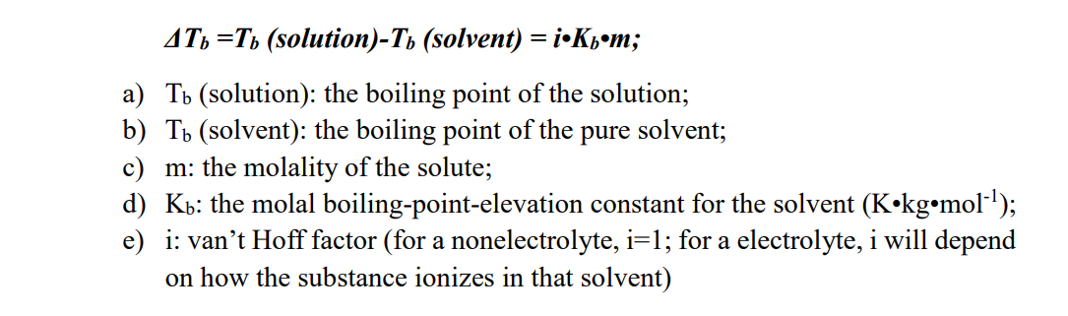
10. A 1.35 m aqueous solution of compound X had a boiling point of 101.4 °C. Which one of the following could be compound X? The boiling point elevation constant for water is 0.52 °C/m. ________
A) CH₃CH₂OH
B) C₆H₁₂O₆
C) Na₃PO₄
D) KCl
E) CaCl₂
D
△Tb=1.4 °C =i*0.52 °C/m * 1.35
i = 1.994

Slide 12
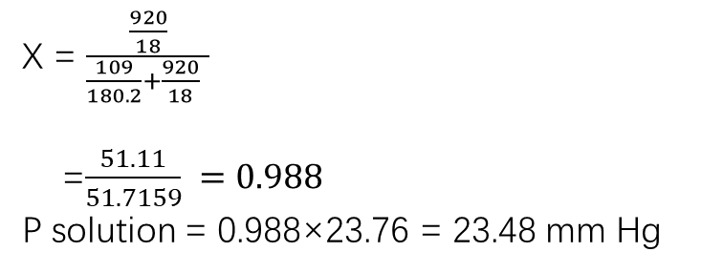
11. Calculate the vapor pressure of a solution made by dissolving 109 grams of glucose (molar mass = 180.2 g/mol) in 920.0 ml of water at 25 ºC. The vapor pressure of pure water at 25 ºC is 23.76 mm Hg. Assume the density of the solution is 1.00 g/mL.
Answer: 23.48 mm Hg
X = $\frac{\frac{920}{18}}{\frac{109}{180.2}+\frac{920}{18} }$
=$\frac{51.11}{51.7159} =0.988$
P solution = 0.988×23.76 = 23.48 mm Hg

